Slide 1
AutoCompleteTextView
AutoCompleteTextView is a view that is similar to EditText, except that it shows a list of completion suggestions automatically while the user is typing.
The list of suggestions is displayed in drop down menu. The user can choose an item from there to replace the content of edit box.
Android AutoCompleteTextView is the subclass of EditText class.

Slide 2
AutoCompleteTextView
All the programming languages are stored in string array. We are using the ArrayAdapter class to display the array content.
<TextView
android:layout_width="wrap_content"
android:layout_height="wrap_content"
android:text="What is your favourite programming language?"
app:layout_constraintBottom_toBottomOf="parent"
app:layout_constraintLeft_toLeftOf="parent"
app:layout_constraintRight_toRightOf="parent"
app:layout_constraintTop_toTopOf="parent"
app:layout_constraintVertical_bias="0.032" />
<AutoCompleteTextView
android:id="@+id/autoCompleteTextView"
android:layout_width="200dp"
android:layout_height="wrap_content"
android:layout_marginLeft="92dp"
android:layout_marginTop="144dp"
android:text=""
app:layout_constraintStart_toStartOf="parent"
app:layout_constraintTop_toTopOf="parent" />

Slide 3
AutoCompleteTextView
public class MainActivity extends AppCompatActivity {
String[] language ={"C","C++","Java",".NET","iPhone","Android","ASP.NET","PHP"};
@Override
protected void onCreate(Bundle savedInstanceState) {
super.onCreate(savedInstanceState);
setContentView(R.layout.activity_main);
//Creating the instance of ArrayAdapter containing list of language names
ArrayAdapter<String> adapter = new ArrayAdapter<String>
(this,android.R.layout.select_dialog_item,language);
//Getting the instance of AutoCompleteTextView
AutoCompleteTextView actv = findViewById(R.id.autoCompleteTextView);
actv.setThreshold(1);//will start working from first character
actv.setAdapter(adapter);//setting the adapter data into the AutoCompleteTextView
actv.setTextColor(Color.RED);
}
}

Slide 4
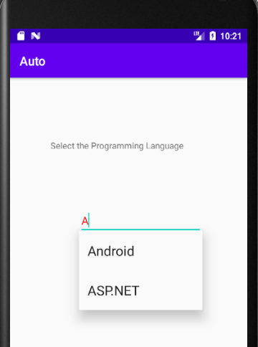
AutoCompleteTextView

Slide 5
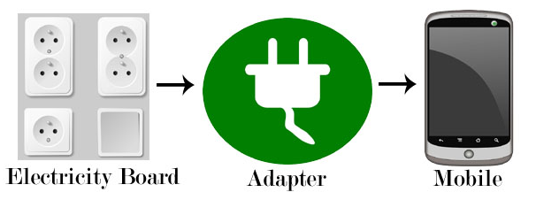
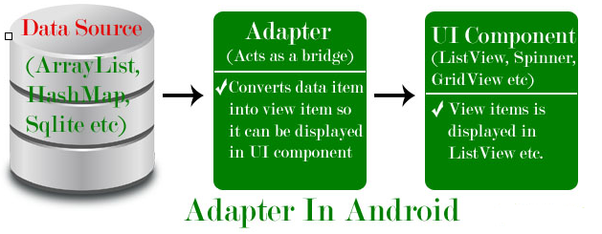
Adapter
Adapter is a bridge between UI component and data source that helps us to fill data in UI component.
It holds the data and send the data to an Adapter view then view can takes the data from the adapter view and shows the data on different views like as ListView, GridView, Spinner etc.
To fill data in a list or a grid we need to implement Adapter.
Here data source is the source from where we get the data and UI components are list or grid items in which we want to display that data.

Slide 6
Adapter
Adapters In Android:
There are the some commonly used Adapter in Android used to fill the data in the UI components:
BaseAdapter – It is parent adapter for all other adapters
ArrayAdapter – It is used whenever we have a list of single items which is backed by an array
Custom ArrayAdapter – It is used whenever we need to display a custom list
SimpleAdapter – It is an easy adapter to map static data to views defined in your XML file
Custom SimpleAdapter – It is used whenever we need to display a customized list and needed to access the child items of the list or grid
Note :
ArrayAdapter is more simple and commonly used Adapter in android.
Whenever you have a list of single type of items like an array, we use ArrayAdapter.
Ex. List of phone contacts, countries or names.

Slide 7
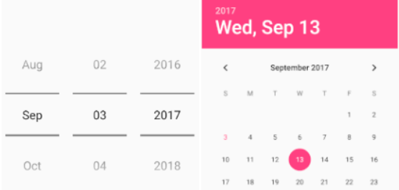
DatePicker
DatePicker is a control that will allow users to select the date by a day, month and year in our application user interface.
DatePicker is available in two modes, one is to show the complete calendar and another one is to show the dates in spinner view.

Slide 8
DatePicker
<DatePicker
android:id="@+id/datePicker1"
android:layout_width="wrap_content"
android:layout_height="wrap_content"
android:datePickerMode="calendar"/>
(OR)
<DatePicker
android:id="@+id/datePicker1"
android:layout_width="wrap_content"
android:layout_height="wrap_content"
android:datePickerMode="spinner"
android:calendarViewShown="false"/>

Slide 9
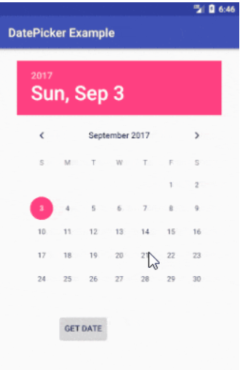
DatePicker - Example

Slide 10
DatePicker - Example
<?xml version="1.0" encoding="utf-8"?>
<RelativeLayout xmlns:android="http://schemas.android.com/apk/res/android"
android:layout_width="match_parent" android:layout_height="match_parent">
<DatePicker
android:id="@+id/datePicker1"
android:layout_width="wrap_content"
android:layout_height="wrap_content"
android:layout_centerHorizontal="true"
android:layout_marginTop="20dp" />
<Button
android:id="@+id/button1"
android:layout_width="wrap_content"
android:layout_height="wrap_content"
android:layout_below="@+id/datePicker1"
android:layout_marginLeft="100dp"
android:text="Get Date" />
<TextView
android:id="@+id/textView1"
android:layout_width="wrap_content"
android:layout_height="wrap_content"
android:layout_below="@+id/button1"
android:layout_marginLeft="100dp"
android:layout_marginTop="10dp"
android:textStyle="bold"
android:textSize="18dp"/>
</RelativeLayout>

Slide 11
DatePicker - Example
public class MainActivity extends AppCompatActivity {
DatePicker picker;
Button btnGet;
TextView tvw;
@Override
protected void onCreate(Bundle savedInstanceState) {
super.onCreate(savedInstanceState);
setContentView(R.layout.activity_main);
tvw=findViewById(R.id.textView1);
picker=findViewById(R.id.datePicker1);
btnGet=findViewById(R.id.button1);
btnGet.setOnClickListener(new View.OnClickListener() {
@Override
public void onClick(View v) {
tvw.setText("Selected Date: "+ picker.getDayOfMonth()+"/"+ (picker.getMonth() + 1)+"/"+picker.getYear());
}
});
}
}

Slide 12
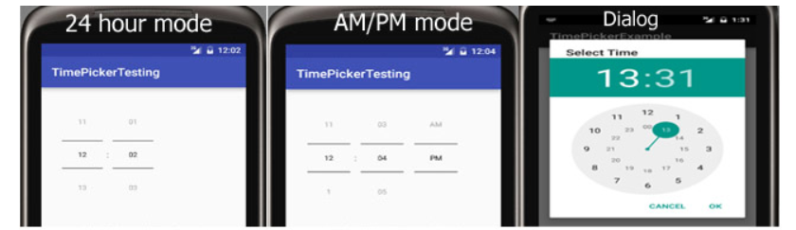
TimePicker
TimePicker is a widget used for selecting the time of the day in either AM/PM mode or 24 hours mode.
The displayed time consist of hours, minutes and clock format.

Slide 13
TimePicker
TimePicker is a widget used for selecting the time of the day in either AM/PM mode or 24 hours mode.
The displayed time consist of hours, minutes and clock format.
<TimePicker
android:id="@+id/simpleTimePicker"
android:layout_width="wrap_content"
android:layout_height="wrap_content"
android:timePickerMode="spinner" />
TimePicker simpleTimePicker=findViewById(R.id.simpleTimePicker);
//initiate a time picker
simpleTimePicker.setBackgroundColor(Color.YELLOW);
//Yellow background color for the background of a time picker

Slide 14
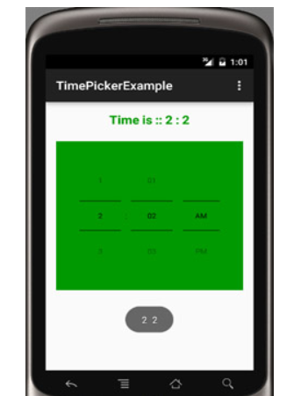
TimePicker

Slide 15
TimePicker - Example
<RelativeLayout xmlns:android="http://schemas.android.com/apk/res/android"
xmlns:tools="http://schemas.android.com/tools"
android:layout_width="match_parent"
android:layout_height="match_parent"
android:paddingBottom="@dimen/activity_vertical_margin"
android:paddingLeft="@dimen/activity_horizontal_margin"
android:paddingRight="@dimen/activity_horizontal_margin"
android:paddingTop="@dimen/activity_vertical_margin"
tools:context=".MainActivity">
<TimePicker
android:id="@+id/simpleTimePicker"
android:layout_width="wrap_content"
android:layout_height="wrap_content"
android:layout_centerHorizontal="true"
android:layout_marginTop="50dp"
android:background="#090"
android:padding="20dp"
android:timePickerMode="spinner" />
<TextView
android:id="@+id/time"
android:layout_width="wrap_content"
android:layout_height="wrap_content"
android:layout_centerHorizontal="true"
android:text="Time Is ::"
android:textColor="#090"
android:textSize="20sp"
android:textStyle="bold" />
</RelativeLayout>

Slide 16
TimePicker - Example
public class MainActivity extends AppCompatActivity {
TextView time;
TimePicker simpleTimePicker;
@Override
protected void onCreate(Bundle savedInstanceState) {
super.onCreate(savedInstanceState);
setContentView(R.layout.activity_main);
time =findViewById(R.id.time);
simpleTimePicker = findViewById(R.id.simpleTimePicker);
// simpleTimePicker.setIs24HourView(false); // used to display AM/PM mode
// perform set on time changed listener event
simpleTimePicker.setOnTimeChangedListener(new TimePicker.OnTimeChangedListener() {
@Override
public void onTimeChanged(TimePicker view, int hourOfDay, int minute) {
// display a toast with changed values of time picker
Toast.makeText(getApplicationContext(), hourOfDay + " " + minute, Toast.LENGTH_SHORT).show();
time.setText("Time is :: " + hourOfDay + " : " + minute); // set the current time in text view
}
});
}
}

